Slide 1
WHAT ARE SKILLSET AND BECTU ALL ABOUT
EMILY HALES

Slide 2
Skillset Careers is to help provide creative industry information for TV, Film, Radio, Interactive media, Animation, Computer Games, Facilities, Photo Imaging ,Publishing, Advertising and Fashion and Textiles. There goal is to support the productivity within their industry and to ensure it remains globally competitive. Ways in which they do this is by influencing and leading; developing skills, training and education policy; and through opening up the industries to the UK's diverse talent. They provide consultation work with industry, publish research and strategic documents, run funding schemes and project work, and supply information about the tests and challenges that they come across in the industry and how they overcome them. People that are trying to route into the creative media industry Skillset also provide there help and support by establishing industry professional online or via phone, whether you’re a freelancer looking for training tips and information, a student wanting to know more about the media industries or a public agency partner.

Slide 3
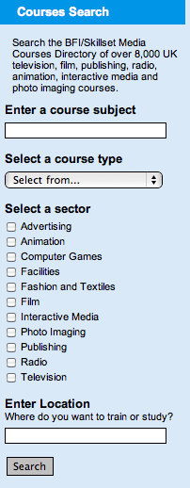
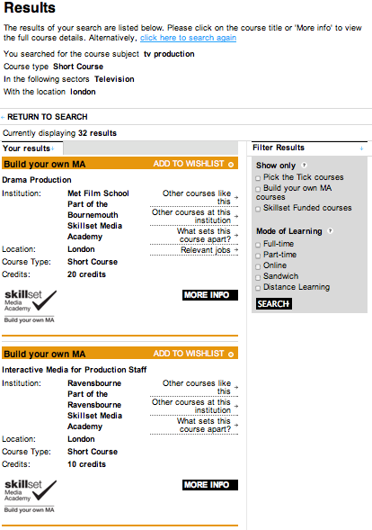
These two screenshots are for students especially if they come across skillset this is how they would get involved..
⬆
This bit of information is so that SkillSet can also help you with the courses you want to do and help you give advice on where to go and the best decision for you.
⬆
The course you were looking for then shows the results and shows you the universities and colleges in which they do your specific course and then you click on whatever one your interested in and supplies you with the information.
This is the course search where you would type in the course your interested in and what you want to study ..
⬅

Slide 4
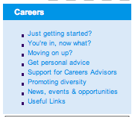
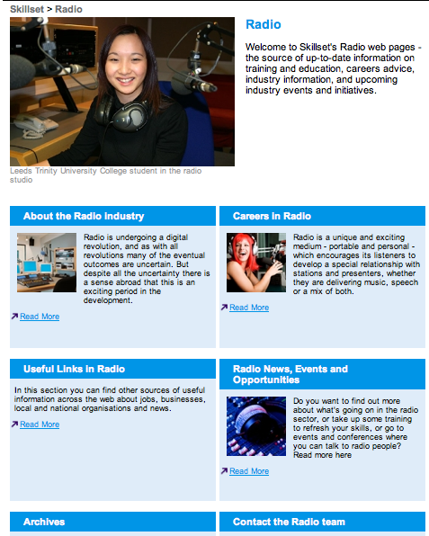
This part is for people finding at how to get into creative industries, Skillset supplies advice, links and events on how to exactly do what you love.
⬅
⬆
This bar will be at the side of the site and this is just about Skillset and what they are all about.
This is a page example (radio) Skillset when you’ve clicked on a creative industry it will come to this page and it will tell you about that industry, carrers in the industry and news, events and opportunities and then you click the one you want and more information will show.
➔

Slide 5
The BECTU which stands for Broadcasting Entertainment Cinematograph and Theatre Union is different to Skillset, BECTU is the independent trade union for those working in broadcasting, film, theatre, entertainment, leisure, interactive media and allied areas. The union represents staff and contract and freelance workers who are based primarily in the United Kingdom. 25,000+ members are provided with BECTU, they provide a wide range of services, including Negotiating pay, conditions and contracts with employers, Personal advice and representation for individual members, Advice and representation on health and safety, Benefits and services for BECTU members, A union journal, Stage Screen and Radio published eight times a year, A website designed to improve access to the union's advice and support. The key aims of the union are to: protect jobs, increase membership, win new recognition agreements, improve pay and conditions of service, including pensions.

Slide 6
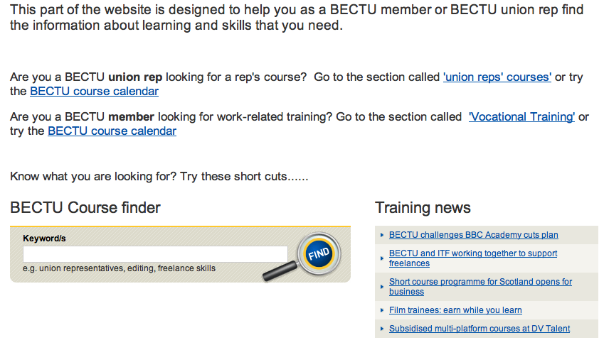
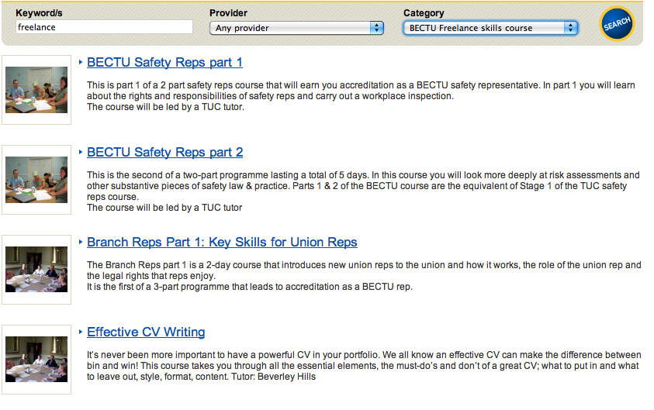
You then end up on this page and it gives you tips and courses related to your course and how to achieve the best that you’ve got.
⬇
⬆
This part of the website comes under training and education. This is to help BECTU members to find out about their courses and training courses that they are interested in.

Slide 7
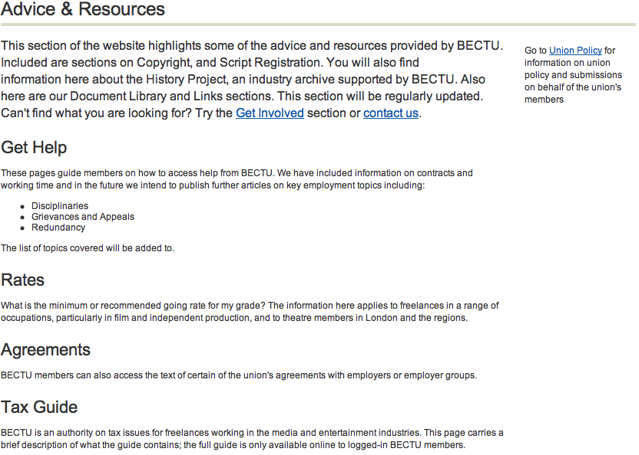
This part of the website comes fromf advice and resources this gives the BECTU members guidance's and help get involved.
⬅

